Slide 1
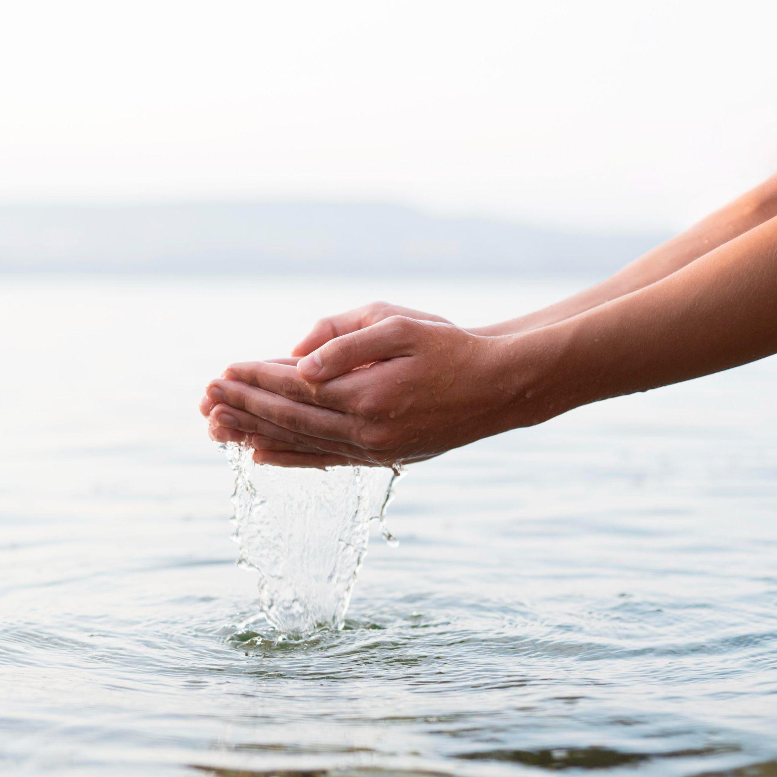
WATER QUALITY PREDICTION

Slide 2
TEAM MEMBERS
SIRI H G
SHRADDHA SHRESTHA
MALLIKARJUN AITHA
MADHAVI KANCHAM
Model Development
Exploratory Data Analysis
Data Visualization
Data Deployment

Slide 3
Problem Statement | How about developing a model to predict the Water Quality Index (WQI) for a specific location based on parameters such as pH, turbidity, dissolved oxygen, and chemical concentrations? Is it feasible to create a model that predicts water potability for different geographic regions, considering regional variations in water quality parameters, for the benefit of regional health and development initiatives?. Can a system be developed to support sustainable water resource management by predicting water potability and identifying contamination sources, especially in regions with stressed water resources?

Slide 4
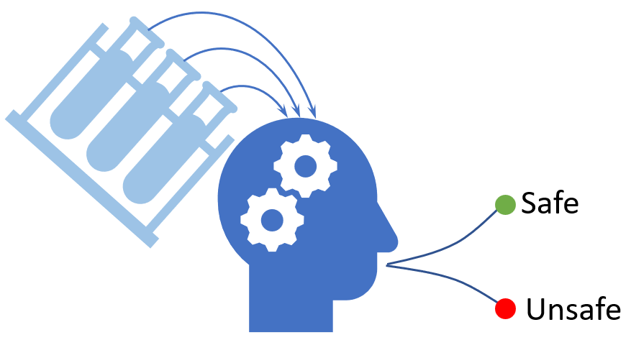
Business Questions
How can businesses assure consumers of the safety and quality of their water-based products (e.g., beverages or food products) in regions with varying water potability standards?
How can businesses incorporate initiatives related to improving access to safe drinking water into their CSR programs, benefiting local communities and enhancing their brand image?
How can businesses in healthcare, pharmaceuticals, and insurance assess the potential costs and benefits of proactive health programs related to water quality and consumption?

Slide 5
Solution
To develop a model for WQI prediction, collect historical data for the specified parameters at the target location, preprocess the data, and apply machine learning algorithms for regression analysis to predict the WQI.
Collect and integrate water quality data from various water bodies. Apply data science techniques, to develop a predictive model for water potability that considers regional variations. This model can inform regional health and development efforts and can be applied in various regions.
Gather data on water quality parameters, potential contamination sources, and historical potability records. Use machine learning and analytical tools to predict water potability and identify contamination sources. This system can aid in sustainable water management and resource allocation in water-stressed regions.

Slide 6
Project Pipeline
Data Collection
Data Cleanup & Exploration
Data Processing
Data Visualization
Data Analysis

Slide 7
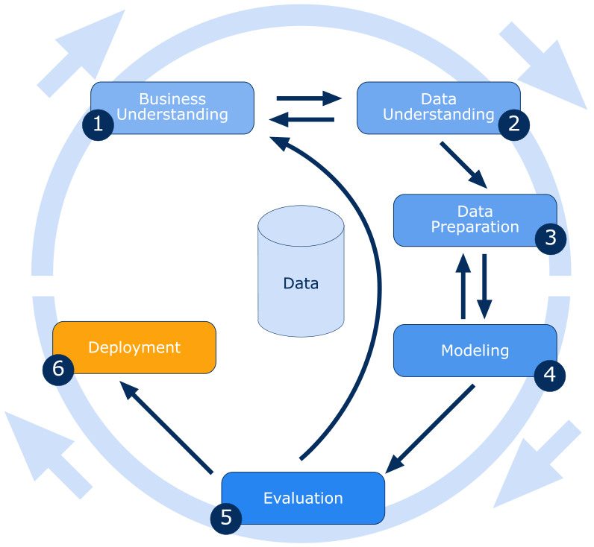
Methodology (CRISP-DM MODEL)

Slide 8
Data understanding
It includes parameters like pH, hardness, total dissolved solids (TDS), chloramines, sulfate, conductivity, organic carbon, trihalomethanes, turbidity, and potability (indicating water safety).
Initial exploration suggests that most parameters fall within the recommended ranges set by organizations like WHO for safe drinking water. However, there may be variations in water quality that could impact potability.
The dataset provides an opportunity to predict water potability based on these metrics, contributing to public health and regulatory compliance efforts

Slide 9
Data preparation and Visualization
Prepared the data set with the identification of columns with missing values (pH, sulfate, and Trihalomethanes), thus handled the missing values and visualized the missing values using a heatmap, calculated the percentage of missing values, and used median imputation to fill in the missing values for these columns.
Explored the dataset through various visualizations, including histograms, scatterplots, and correlation matrices, to understand the relationships between variables.

Slide 10
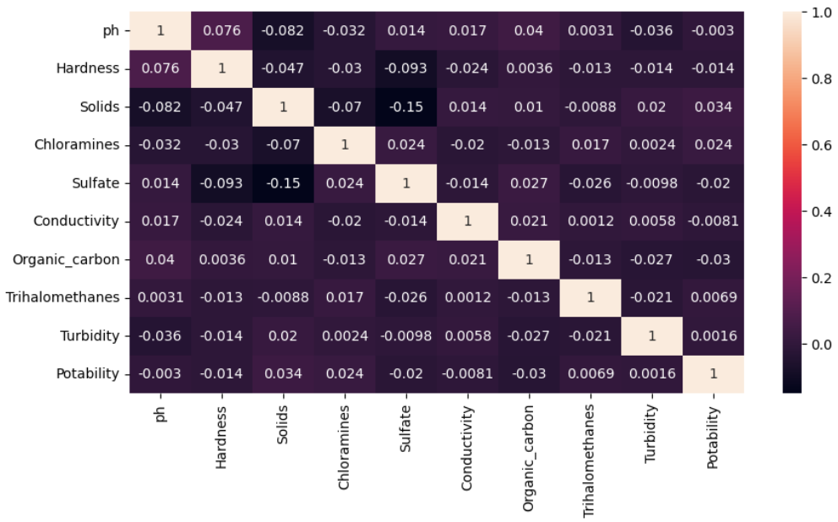

Slide 11





Technologies

Slide 12
Resources
https://www.kaggle.com/datasets/adityakadiwal/water-potability/data
https://www.linkedin.com/learning/data-science-foundations-fundamentals-14537508/data-preparation?u=2359714
https://www.linkedin.com/learning/hands-on-introduction-data-engineering/hands-on-data-engineering?u=2359714
https://www.coursera.org/learn/python-for-data-visualization

Slide 13
THANK YOU!

